Slide 1
Regression Analysis
Model Selection
Nicoleta Serban, Ph.D.
Professor
Stewart School of Industrial and Systems Engineering
Data Examples

Slide 2

About This Lesson

Slide 3
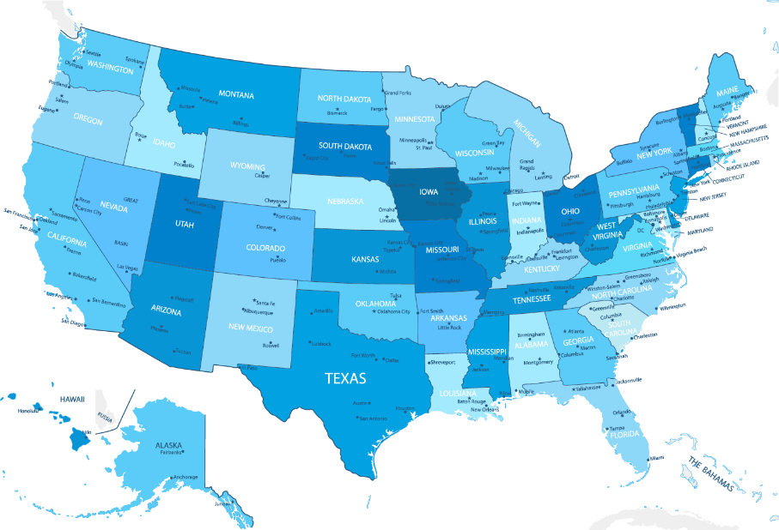
Ranking States by SAT Performance
Which variables are associated with state average SAT scores?
After accounting for selection biases, how do the states rank?
Which states perform best for the amount of money they spend?
SAT Mean Score by State – Year 1982
790 (South Carolina) – 1088 (Iowa)

Slide 4
Response & Predicting Variables
The response variable is:
Y = State average SAT score (verbal and quantitative combined)
The predicting variables are:
takers % of eligible students (high school seniors) in state who took the exam
rank Median percentile ranking of test takers in their secondary school classes
income Median income of families of test takers (in $00's)
years Average years test takers had in social/natural sciences and humanities
public % of test takers who attended public schools
expend State expenditure on secondary schools (in $00's/student)

Slide 5
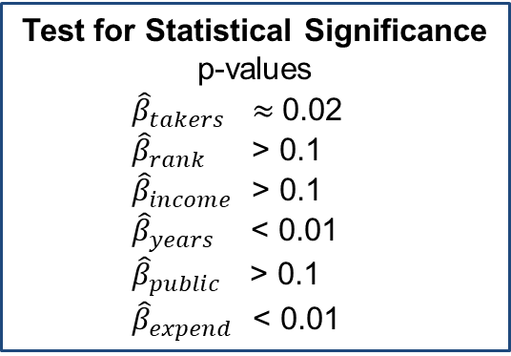
Regression Analysis
regression.line = lm(sat ~ log(takers) + rank + income + years + public + expend)
summary(regression.line)
Coefficients:
Test for Statistical Significance
p-values
  ${\hat{β}}_{takers}$ ≈ 0.02
  ${\hat{β}}_{rank}$ > 0.1
  ${\hat{β}}_{income}$ > 0.1
  ${\hat{β}}_{years}$ < 0.01
  ${\hat{β}}_{public}$ > 0.1
  ${\hat{β}}_{expend}$ < 0.01
 | Estimate | Std. Error | t value | Pr(>|t|)
(Intercept) | 407.53990 | 282.76325 | 1.441 | 0.15675
log(takers) | -38.43758 | 15.95214 | -2.410 | 0.02032 *
rank | 4.11427 | 2.50166 | 1.645 | 0.10734
income | -0.03588 | 0.13011 | -0.276 | 0.78407
years | 17.21811 | 6.32007 | 2.724 | 0.00928 **
public | -0.11301 | 0.56239 | -0.201 | 0.84168
expend | 2.56691 | 0.80641 | 3.183 | 0.00271 **
Shall we discard the predicting variables with regression coefficients that are not statistically significant?
➔ NO. Perform variable selection.

Slide 6
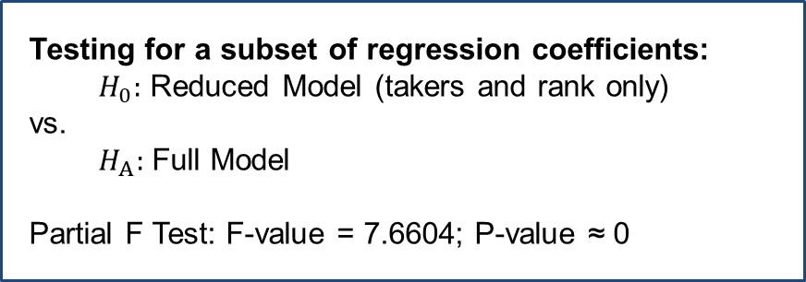
Inference on Subset of Coefficients
regression.red = lm(sat ~ log(takers) + rank)
anova(regression.red, regression.line)
Model 1: sat ~ log(takers) + rank
Model 2: sat ~ log(takers) + rank + income + years + public + expend
 | Res.Df | RSS | Df | Sum of Sq | F | Pr(>F)
1 | 47 | 45530
2 | 43 | 26585 | 4 | 18945 | 7.6604 | 9.42e-05 ***
Testing for a subset of regression coefficients:
$H_{0}:$ Reduced Model (takers and rank only)
vs.
$H_{A}:$ Full Model
Partial F Test: F-value = 7.6604; P-value ≈ 0

Slide 7
Inference on Subset of Coefficients
regression.red = lm(sat ~ log(takers) + rank)
anova(regression.red, regression.line)
Model 1: sat ~ log(takers) + rank
Model 2: sat ~ log(takers) + rank + income + years + public + expend
 | Res.Df | RSS | Df | Sum of Sq | F | Pr(>F)
1 | 47 | 45530
2 | 43 | 26585 | 4 | 18945 | 7.6604 | 9.42e-05 ***
Controlling and explanatory variables: log(takers) and rank need to be in the model.
Partial F test for explanatory variables: at least one predicting variable has explanatory power. Which ones?
➔ Perform variable selection!!!

Slide 8
Predicting Bankruptcy
Effective bankruptcy prediction is useful for investors and analysts, allowing for accurate evaluation of a firm’s prospects.
Roughly 40 years ago, Ed Altman showed that publicly available financial indicators can be used to distinguish between firms that are about to go bankrupt and those that are not.
Which financial indicators are associated with bankruptcy for telecommunications firms?
Acknowledgement: This example was provided by Dr. Jeffrey Simonoff from New York University and was inspired by the honors thesis of Jeffrey Lui.

Slide 9
Bankruptcy Data
Data Sample:
25 telecommunication firms that declared bankruptcy 2000–2002
25 telecommunication firms that did not declare bankruptcy, “matched” according to the asset size of the bankrupt firms
Replicate Experimental Data Setting:
Matching firms to be comparable with respect to meaningful factors
Allowing for causal inference

Slide 10
Response & Predicting Variables
The response variable is:
Y = Whether the firm declared bankruptcy
The predicting variables are:
WC.TA Working capital as a percentage of total assets (in %)
RE.TA Retained earnings as a percentage of total assets (in %)
EBIT.TA Earnings before interest and taxes as a percentage of total assets (in %)
S.TA Sales as a percentage of total assets (in %)
BE.T Book value of equity divided by book value of total liabilities

Slide 11
Exploratory Data Analysis
## Read the data from the file## Exploratory analysis
bankruptcy = read.table("bankruptcy.dat", sep="\t", header=T, row.names=NULL)
attach(bankruptcy)
## Exploratory analysis
par(mfrow=c(2,3))
boxplot(split(WC.TA,Bankrupt), style.bxp="old", xlab="Bankrupt", ylab="WC.TA",
main="Boxplot of WC/TA")
boxplot(split(RE.TA,Bankrupt), style.bxp="old", xlab="Bankrupt", ylab="RE.TA",
main="Boxplot of RE/TA")
boxplot(split(EBIT.TA,Bankrupt), style.bxp="old", xlab="Bankrupt", ylab="EBIT.TA",
main="Boxplot of EBIT/TA")
boxplot(split(S.TA,Bankrupt), style.bxp="old", xlab="Bankrupt", ylab="S.TA",
main="Boxplot of S/TA")
boxplot(split(BVE.BVL,Bankrupt), style.bxp="old", xlab="Bankrupt", ylab="BVE.BVL",
main="Boxplot of BVE/BVL")

Slide 12
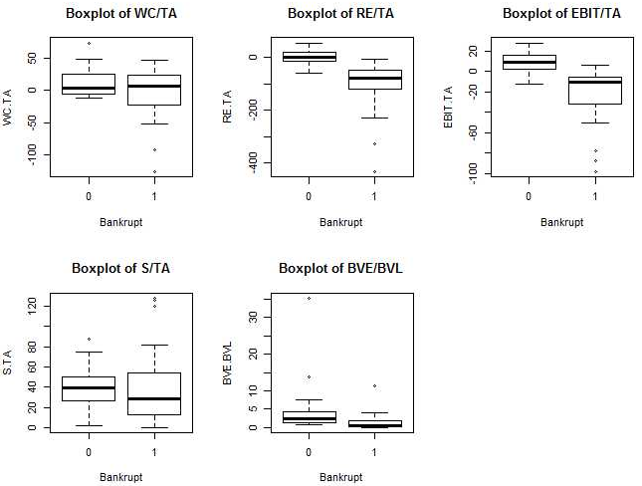
Exploratory Data Analysis

Slide 13
Regression Analysis
bank1 = glm(Bankrupt ~ WC.TA + RE.TA + EBIT.TA + S.TA + BVE.BVL, family=binomial)
summary(bank1)
Coefficients:
gstat = bank1$null.deviance - deviance(bank1)
cbind(gstat, 1 - pchisq(gstat, length(coef(bank1))-1))
gstat
[1,] 57.46799 4.049594e-11
Test for Statistical Significance
All p-values > 0.1
None of the coefficients are statistically significant.
 | Estimate | Std. Error | z value | Pr(>|z|)
(Intercept) | 7.42646 | 6.35770 | 1.168 | 0.243
WC.TA | -0.15587 | 0.12208 | -1.277 | 0.202
RE.TA | -0.07605 | 0.06311 | -1.205 | 0.228
EBIT.TA | -0.49111 | 0.32260 | -1.522 | 0.128
S.TA | -0.08040 | 0.09216 | -0.872 | 0.383
BVE.BVL | -2.07764 | 1.47488 | -1.409 | 0.159
Test for Overall Regression
p-value ≈ 0
The overall regression has predictive power.

Slide 14

Summary

